Slide 1
Web Design Lecture – 2E
Instructor: Vishal Chawla

Slide 2
Helper Applications & Plug-ins
Helper Application
A program that can be designated to handle a particular file type (such as .wav or.mpg) to allow the user to view or otherwise utilize the special file.
The helper application runs in a separate window from the browser.
Plug-In
A newer and more common method
Plug-ins run right in the browser window so that media objects can be integrated directly into the web page.
Source: Basics of Web Design (HTML5 and CSS3)

Slide 3
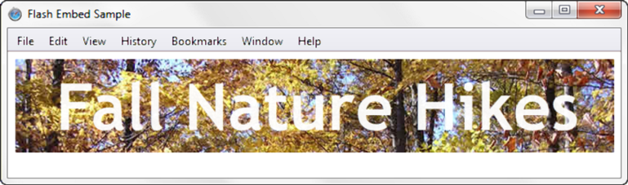
HTML5 Embed Element
<embed type="application/x-shockwave-flash" src="fall5.swf"
width="640"
height="100"
quality="high”
title="Fall Nature Hikes">
Source: Basics of Web Design (HTML5 and CSS3)
Notes:
11.2

Slide 4
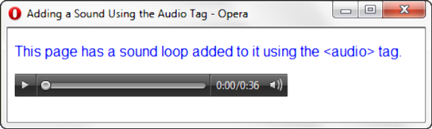
HTML5 Audio & Source Elements
<audio controls="controls">
<source src="soundloop.mp3" type="audio/mpeg">
<source src="soundloop.ogg" type="audio/ogg">
<a href="soundloop.mp3">Download the Audio File</a> (MP3)
</audio>
Source: Basics of Web Design (HTML5 and CSS3)
Notes:
11.3

Slide 5
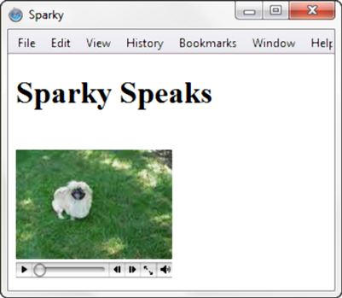
HTML5 Video & Source Elements
<video controls="controls" poster="sparky.jpg"
width="160" height="150">
<source src="sparky.m4v" type="video/mp4">
<source src="sparky.ogv" type="video/ogg">
<a href="sparky.mov">Sparky the Dog</a> (.mov)
</video>
Source: Basics of Web Design (HTML5 and CSS3)

Slide 6
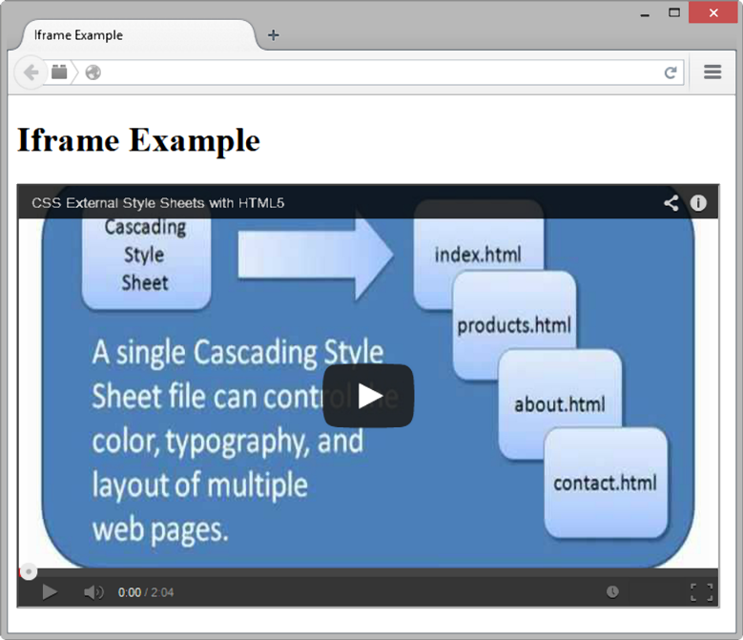
Use the iframe element to embed YouTube Video
<iframe src="http://www.youtube.com/embed/VIDEO_ID" width="640" height="385"> View the <a href="http://www.youtube.com/watch?v=VIDEO_ID">YouTube Video</a> </iframe>
Source: Basics of Web Design (HTML5 and CSS3)

Slide 7
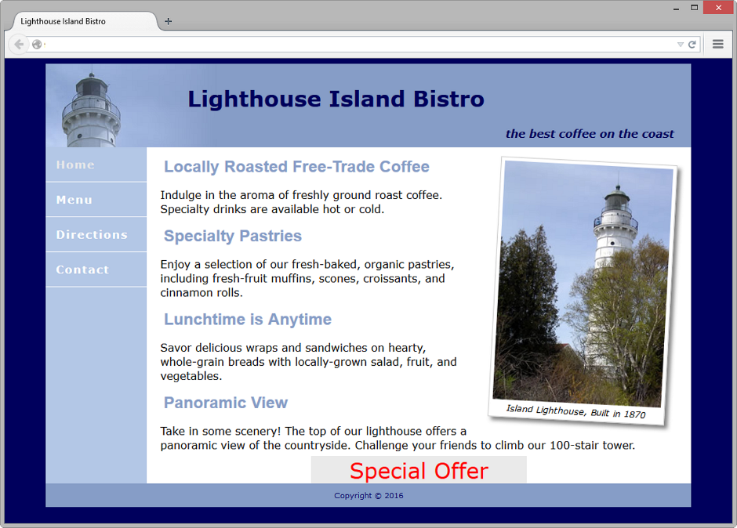
CSS3 Transform Property
Allows you to rotate, scale, skew, or move an element
Examples:
Rotate 3 degrees:
transform: rotate(3deg);
Display twice as large:
transform: scale(2);
Source: Basics of Web Design (HTML5 and CSS3)

Slide 8
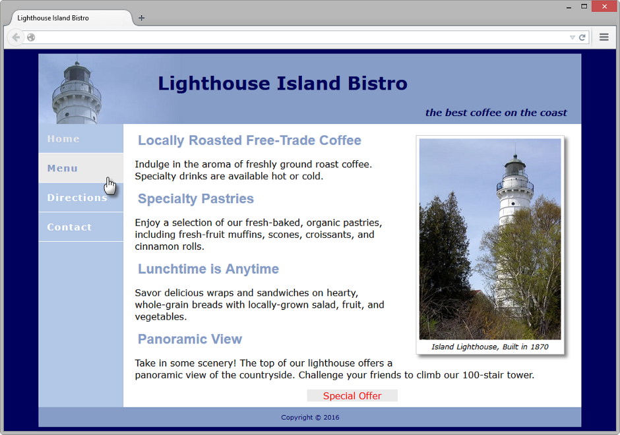
CSS3 Transition Property
Provides for changes in property values to display in a smoother manner over a specified time.
Example:
nav a:hover { color: #869dc7; background-color: #eaeaea;
transition: background-color 2s linear; }
Source: Basics of Web Design (HTML5 and CSS3)

Slide 9
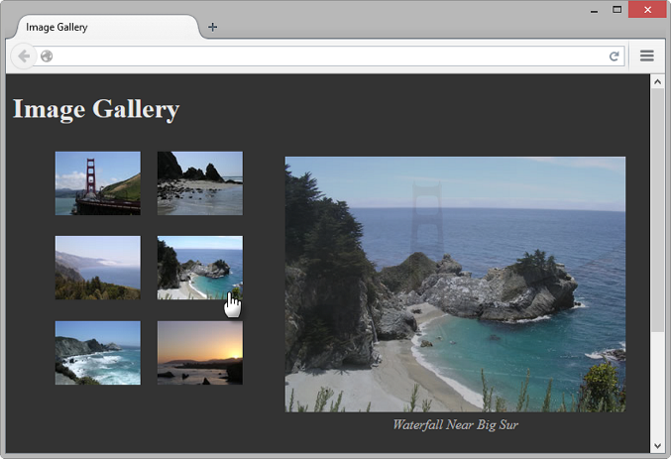
CSS Image Gallery
Configure each thumbnail image:
<li><a href="photo1.jpg"><img src="photo1thumb.jpg" width="100" height="75" alt="Golden Gate Bridge">
<span><img src="photo1.jpg" width="400" height="300“ alt="Golden Gate Bridge"><br>Golden Gate Bridge </span></a>
</li>
The key CSS:
#gallery span { position: absolute;
left: -1000px;; }
#gallery a:hover span { position: absolute;
top: 16px; left: 320px;
text-align: center; }
Source: Basics of Web Design (HTML5 and CSS3)

Slide 10
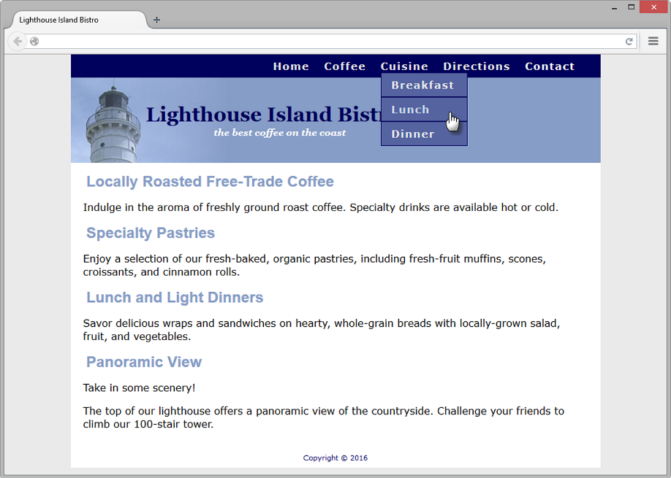
CSS Drop Down Menu
Configure nav container with position relative
Code submenu (drop down menu) ul element with the parent li element
Configure submenu ul element to initially not display
Configure submenu ul element with absolute positioning
Source: Basics of Web Design (HTML5 and CSS3)

Slide 11
HTML5 Web STorage
Traditionally, the JavaScript cookie object has been used to store information in key-value pairs on the client (the website visitor’s computer).
NEW FOR HTML5: Web Storage API
provides two new ways to store information on the client side: local storage and session storage.
Advantage: increase in the amount of data that can be stored (5MB per domain).
The localStorage object stores data without an expiration date.
The sessionStorage object stores data only for the duration of the current browser
JavaScript is used to work with the values stored in the localStorage and sessionStorage objects.
Examples:
http://webdevfoundations.net/storage and http://html5demos.com/storage
Source: Basics of Web Design (HTML5 and CSS3)

